Slide 1

IST 687 – FINAL PROJECT
Forecasting Energy Usage Consumption for eSC Energy Company
Group 3:
Harish Reddy Yedulla
Kunal Jain
Nikitha Chandana
Raghuveera Narasimha
Rishi Siddanth Yaga

Slide 2

PROJECT BACKGROUND
The project involves analyzing energy usage data and weather data for an energy company, eSC, which provides electricity in South Carolina and parts of North Carolina.
The provided data includes static house information, hour-by-hour energy usage for each house, metadata explaining data fields, and hour-by-hour weather information for each geographic area.
The tasks include merging the data, conducting exploratory analysis, building a predictive model for July energy usage, evaluating model accuracy, creating a modified weather dataset assuming higher temperatures, and assessing future energy demand.

Slide 3

PROJECT GOAL
For the eSC project, the goals are twofold:
Predictive Analysis: To predict energy usage patterns, particularly focusing on identifying the factors driving high energy consumption. This involves building models to forecast energy demand, especially during peak periods like July.
Actionable Insights for Energy Savings: To provide strategic recommendations to eSC for reducing overall energy consumption and managing peak demand efficiently. This includes analyzing data to uncover insights and suggest interventions that could lead to significant energy savings and cost reductions.

Slide 4

DATASET OVERVIEW
1.88 million rows, 112 columns
Integrated Analysis Framework: The merged dataset combines energy usage data for each house with corresponding weather data for their respective counties along with the static house data, creating a unified framework for analyzing the interplay between weather conditions and energy consumption.
Enhanced Predictive Insights: This comprehensive dataset facilitates a deeper understanding of energy usage patterns, enabling more accurate predictions and effective strategies for energy management across different regions and climatic conditions.

Slide 5

PROJECT DELIVERABLES
The analysis encompasses a detailed Exploratory Data Analysis (EDA) using techniques like Correlation matrix and scatter plots for initial data insights.
Additionally, it involves the deployment of various machine learning algorithms aimed at accurately forecasting energy consumption patterns across different counties.

Slide 6

BUSINESS QUESTIONS
How can we accurately predict high-energy consumption periods, specifically in July, to optimize resource allocation and reduce operational costs?
What are the primary weather-driven factors influencing energy usage, and how can this knowledge guide the implementation of energy-saving measures?
In the scenario of increased temperatures, what would be the projected peak energy demand, and how can we prepare for this heightened demand?
What strategies can be developed to mitigate peak energy usage, thereby reducing costs and enhancing system efficiency, based on data-driven insights?

Slide 7

EXPLORATORY DATA ANALYSIS

Slide 8
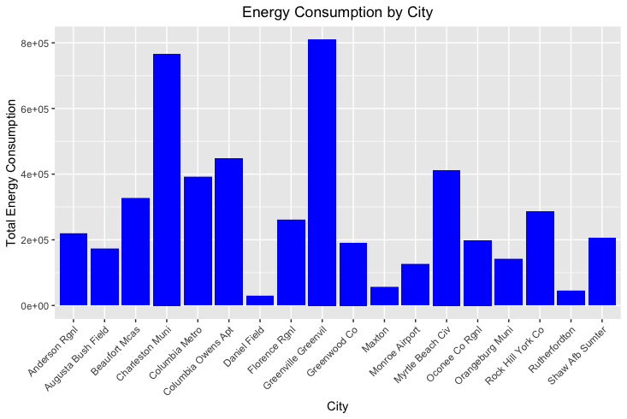
Energy Consumption by City
From this bar chart, the city with the highest energy consumption stands out with a significantly taller bar than the rest, suggesting it is a major consumer of energy and may require focused energy management strategies.
Conversely, the city with the lowest energy consumption has the shortest bar, indicating it has the least energy usage among the listed cities, which could be due to various factors such as smaller population, more efficient energy use, or less industrial activity.
Notes:
The bar chart illustrates the energy consumption across different cities. It clearly shows that one city, in particular, has a significantly higher energy usage compared to others. This could be an area where we need to look into energy-saving measures or efficiency improvements. On the other end, the city with the lowest energy consumption might offer insights into practices that could be replicated elsewhere to reduce our overall energy footprint. Understanding these patterns can help us allocate resources effectively and plan for sustainable growth.

Slide 9
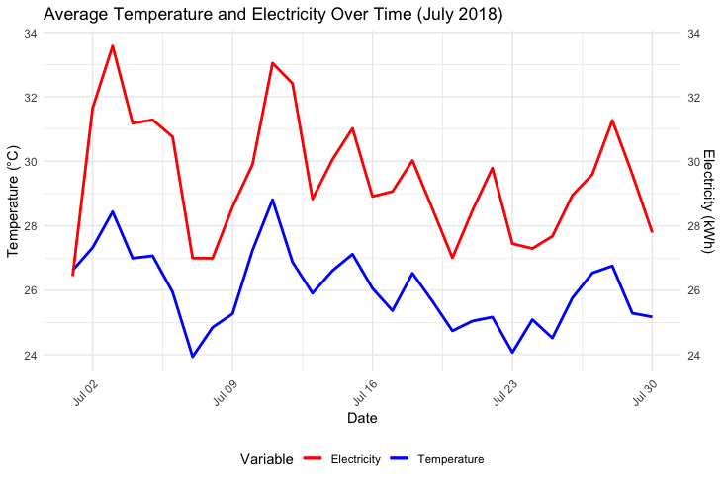
Average Temperature and Electricity over Time (July 2018)
The red line indicates fluctuations in electricity usage with a peak suggesting the highest demand, while the blue line traces temperature variations, with its peak representing the hottest day of the month.
By analyzing both lines, one can often see a correlation between temperature and electricity usage; higher temperatures typically increase electricity demand due to cooling needs, while lower temperatures may decrease it.
Notes:
This graph shows us the relationship between temperature and electricity usage over the month of July 2018. We can observe that as temperatures rise, so does our electricity consumption, likely due to increased use of air conditioning. This pattern helps us anticipate and plan for higher electricity needs during warmer periods, which can be crucial for managing our energy resources and costs effectively. It's a clear indicator of the impact of weather on energy demand.

Slide 10
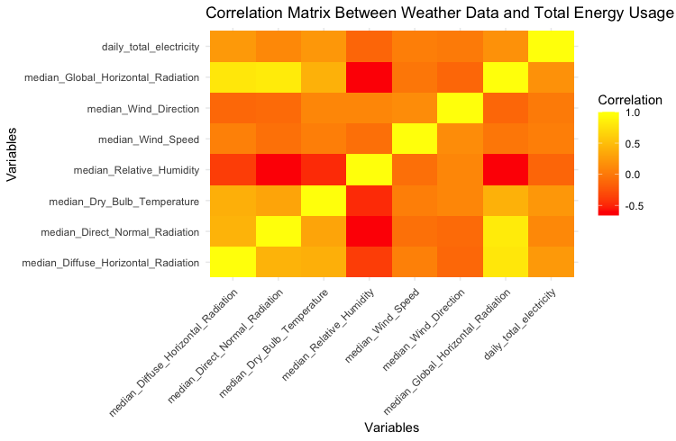
Correlation Matrix
The heatmap is a correlation matrix that displays how various weather-related variables, such as temperature, humidity, and different types of radiation, are correlated with each other and with daily total electricity usage.
Warmer colors (yellow to red) indicate a stronger positive correlation, while cooler colors (green to orange) show little to no correlation, and any shades of color towards the negative side (e.g., red) would indicate a negative correlation.
Notes:
This heatmap is a correlation matrix that shows us how different weather conditions relate to our daily energy usage. The warmer the color, the stronger the relationship. For instance, a bright yellow square indicates a strong positive correlation, which means that as one variable increases, so does the other. This can help us understand which weather factors have the most impact on energy consumption, enabling us to forecast demand and make informed decisions about our energy strategies. It’s a valuable tool for identifying patterns that can affect our operations.

Slide 11
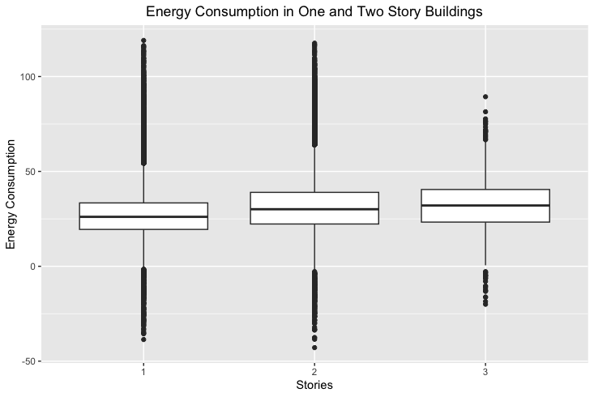
Energy Consumption in One- and Two-Story Buildings
The box plot depicts energy consumption differences in one and two-story buildings, with a third category ambiguously labeled '3'. One-story buildings have a compact interquartile range, suggesting more consistent energy consumption, while two-story buildings show a wider range, indicating greater variability in energy use.
The presence of outliers in all categories suggests there are exceptional cases that do not follow the general consumption patterns.
Notes:
This box plot compares energy consumption across buildings with different stories. The '1' represents one-story buildings, '2' two-story, and '3' three-story buildings. It seems one-story buildings have a wider range of energy consumption than two or three-story buildings, which are more consistent. This information could guide us in focusing energy efficiency efforts on the types of buildings with higher and more variable consumption.

Slide 12
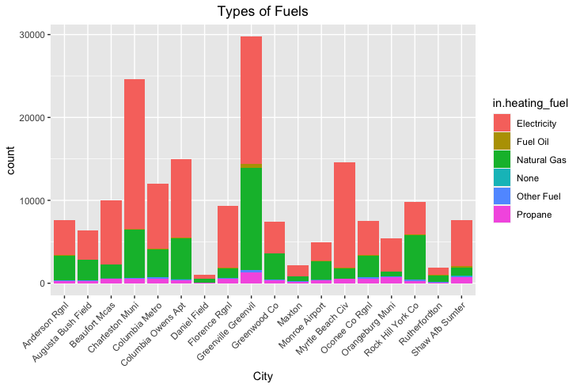
Types of Fuels in Cities
The stacked bar chart shows the count of buildings in various cities categorized by the type of heating fuel used: electricity (red), fuel oil (green), natural gas (purple), no heating (blue), other fuels (cyan), and propane (pink). Each city's bar height indicates the total count of buildings, segmented by the colors to reflect the proportion of each fuel type used within that city.
Red bars represent buildings using electricity for heating, with some cities showing a high count, suggesting a predominant use of electric heating; green bars indicate buildings using fuel oil, which is less common than electricity but still significant in some cities; pink bars denote buildings using propane, which appear as the least used among the three, with relatively low counts across all cities.
Notes:
This stacked bar chart illustrates the types of fuel used across different cities for heating. The different colors represent various fuels like electricity, natural gas, and propane. We can see that some cities rely heavily on electricity, while others have a more diverse mix. This visual can inform us about regional energy preferences and could influence our strategy for energy provision and marketing campaigns tailored to each city's dominant fuel usage.

Slide 13

OUR INTERPRETATION
Analyzing the five graphs leads to the insight that energy consumption patterns are influenced by a variety of factors, including city-specific characteristics, building design, and local climate conditions.
The variation in energy use across cities and building types underscores the importance of localized energy efficiency measures.
Furthermore, the relationship between temperature and electricity usage suggests that weather-dependent energy demands should be a key consideration in urban planning and resource allocation.
After increasing temp by 5, energy usage is predicted to increase by 12.45% with 79.8% accuracy using a Linear Model.

Slide 14
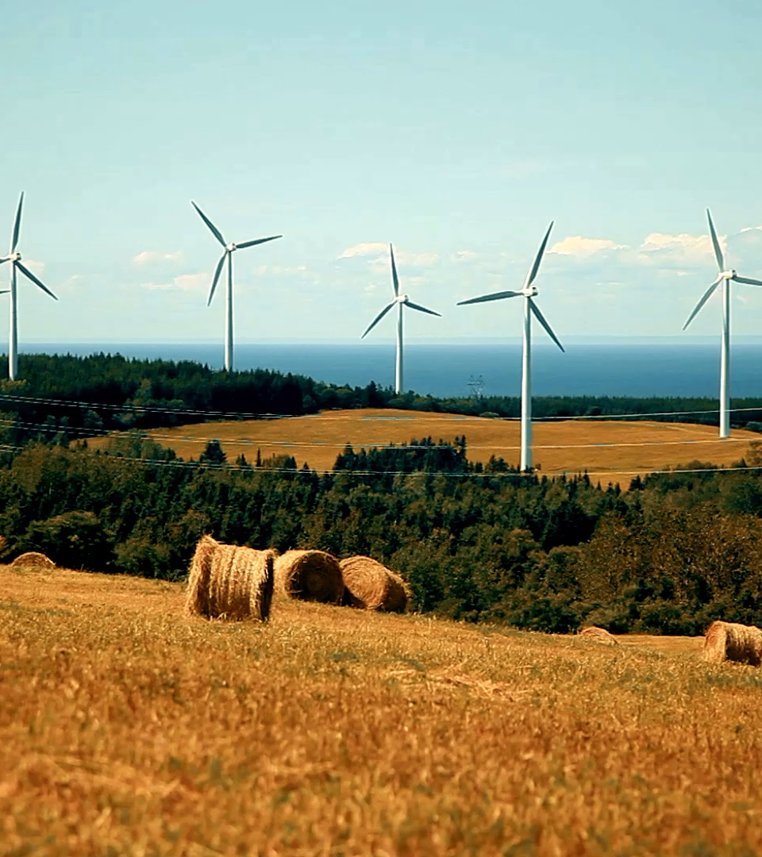
RECOMMENDATIONS
There's a strong correlation between energy consumption, heating methods, and temperature changes. Adapt infrastructure to climate trends by considering insulating material, heating and cooling methods. Save energy by using a optimal method
Expand renewable energy sources to enhance resilience and reduce reliance on non-renewable energy in areas prone to temperature-related energy demand spikes by creating awareness campaigns
Promote energy source diversification in cities heavily reliant on a single fuel type for heating, encouraging the adoption of renewable energy sources like solar and wind for electricity-based heating and cleaner alternatives such as natural gas or biogas for fuel oil-dependent areas.
Implement targeted energy efficiency programs to reduce consumption during peak demand in high-energy-consuming cities by offering incentives for energy-efficient appliances and building retrofits.
These steps will help cities be more sustainable, reduce carbon emissions, and handle extreme temperatures.

Slide 15
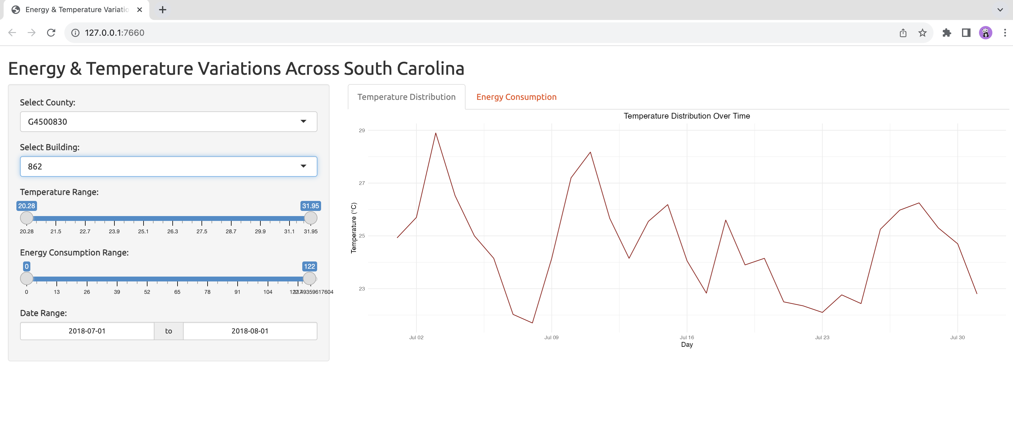
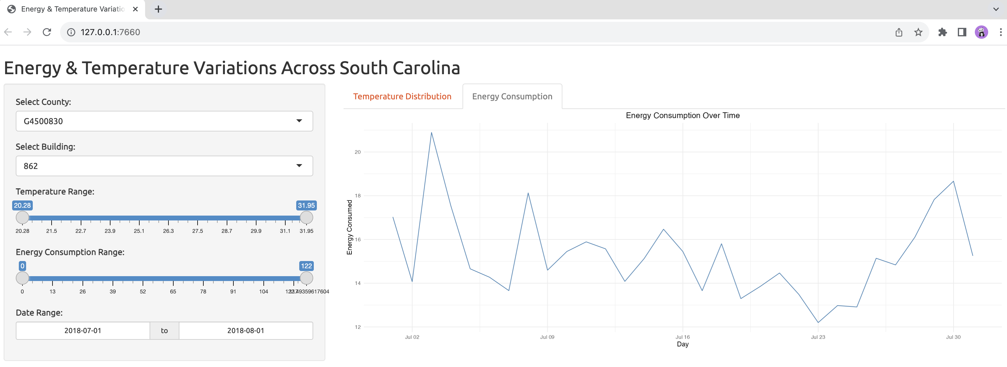
SHINY APP

Slide 16

THANK YOU
ANY QUESTIONS?

